Slide 1
Windows Administration
Telerik Software Academy
academy.telerik.com
Network Configuration
Borislav Varadinov
System Administrator
bobi@itp.bg

Slide 2

Table of Contents
Network and Sharing Center
Configuring Network Adapters
Static Configuration
Alternate Configuration
Static routes
Windows Firewall

Slide 3
Network Settings

Slide 4
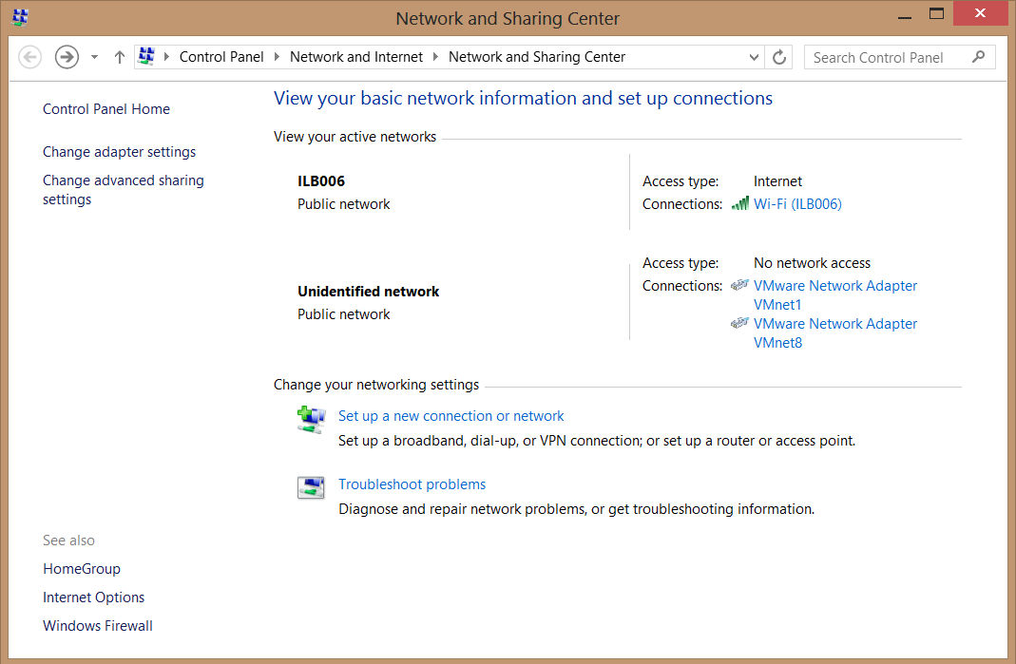
Network and Sharing Center
Open Control Panel
Network and Internet
Network and Sharing Center

Slide 5
Configuring Network Adapters
Open Network and Sharing Center
Change Adapter Settings
Wired
Wireless
You can use the following shortcut
– ncpa.cpl

Slide 6
Static Configuration
Static Configuration
IPV4
IP Address
Netmask
DNS
IPV6
IP Address
Netmask
DNS

Slide 7


Dynamic configuration (DHCP)
Why dynamic configuration?
Manual vs. Dynamic
IPV4
IPV6
Options
DHCP
Server
DHCP Client

Slide 8
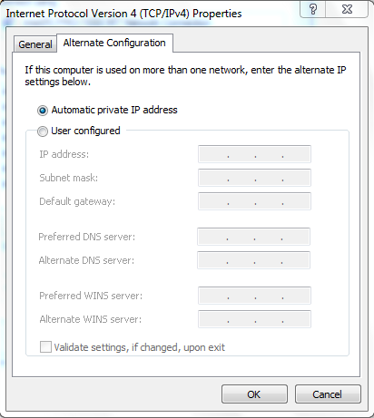
Alternate Configuration

Slide 9
APIPA - Automatic Private IP Addressing IPv4
Clients can automatically self-configure IP addresses when DHCP servers are non-functional
Private range 169.254.0.1 to 169.254.255.254
Meant for non-routed small environments, usually less than 10 devices.

Slide 10
Routing Table

Slide 11
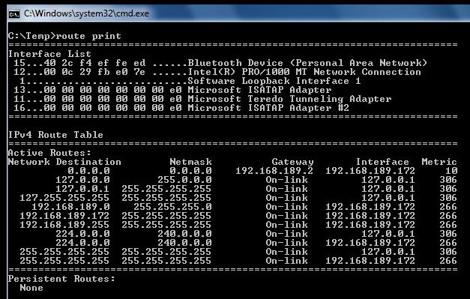
Routing Table

Slide 12
Static routes and Persistent Routes

Slide 13
Network Locations and Firewall

Slide 14
Network Locations
When you connect your computer for first time to a network, you have to specify a network location
There are three network location types
Private networks
Public networks
Domain networks

Slide 15
How Firewalls work?
DestinationAddress: [00-00-5E-00-01-3D] SourceAddress: [B4-B5-2F-31-68-D6]
SourceAddress: 16.52.69.173 DestinationAddress: 16.113.84.10
SrcPort=80 DstPort=61709
Encrypt/Compress/...
Hi, How are you?

Slide 16
Firewall Types
There are two main firewall types
Network perimeter firewall
Host-based firewall

Slide 17
Windows Firewall with Advanced Security
Mitigate some of the risks associated with unauthorized and potentially malicious access to host
Stateful host-based firewall
Blocks incoming connections
Blocks outgoing connections
IPsec connection security rules

Slide 18
Troubleshooting network configuration

Slide 19
Basic troubleshooting
Ipconfig
Ping
Tracert
Pathping
nslookup

Slide 20
Network Configuration
http://academy.telerik.com

Slide 21




Free Trainings @ Telerik Academy
"Web Design with HTML 5, CSS 3 and JavaScript" course @ Telerik Academy
html5course.telerik.com
Telerik Software Academy
academy.telerik.com
Telerik Academy @ Facebook
facebook.com/TelerikAcademy
Telerik Software Academy Forums
forums.academy.telerik.com

